Slide 1
An Introduction to General Purpose GPU Programming
SET10108 Concurrent and Parallel Systems

Slide 2
Breakdown
Graphics Processing Unit
Problem Solving on the GPU
Programming the GPU
Some Frameworks
Examples
Summary

Slide 3
Parallel Problem Types
Task Parallelism
Data Parallelism
Flow of data through processing nodes
Parallelise stages to increase performance
Coordination the problem
Matrix of data to be processed
“Embarrassingly” parallel
Structuring data the problem

Slide 4
Graphics Processing Unit

Slide 5
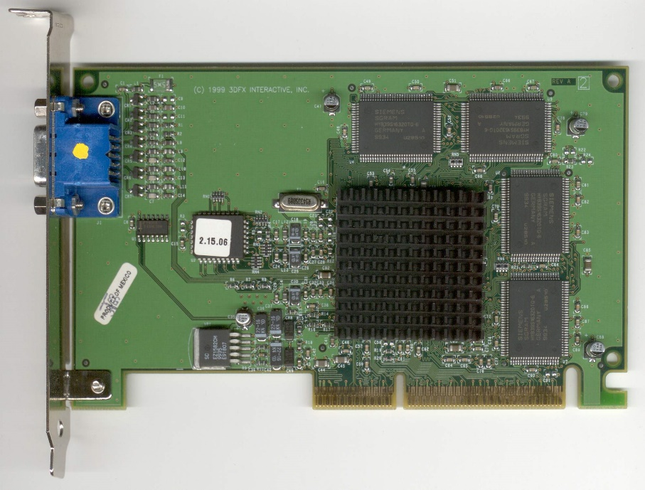
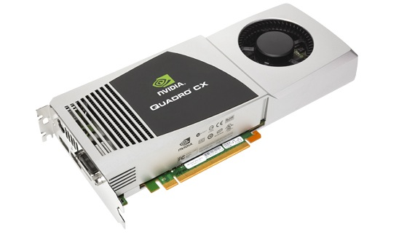
History
1995 Toy Story
Pixar and Renderman
1996 3Dfx Accelerator Cards
4MB, 50MHz clock
1999 Nvidia “GPU”
Texturing and lighting processing

Slide 6

Graphics Processing

Slide 7
Points to Pictures
Point (vertex) data and textures go in one end of the GPU
An image (the render) comes out the other end

Slide 8

Pipeline
The GPU forms a pipeline, transforming point data to pixel data
Vertices processed at start
Triangles in the middle
Pixels at the end
Data driven – independent processing

Slide 9
Shader Programming
Fixed function pipeline allowed only state changes
Light colour, textures, etc.
1980s Pixar’s Renderman provided programmable graphics hardware
2001 Nvidia produces first programmable GPU
Currently four programmable stages
Vertex – per-vertex processing
Fragment – per-pixel processing
Geometry – per-primitive processing (e.g. triangle)
Tessellation – level of detail (add / remove geometry)

Slide 10
Fragment Shader and Textures
Last stage of processing
Can determine colour of pixel (vec4 value)
Can output to a texture buffer
Can be manipulated to process data (very dirty)

Slide 11
Geometry Shader and Stream Output
Last vertex stage
Can work per point
Point primitives
Can output from this stage to memory
No fragment processing
Used for particle effects, fur / hair, etc.

Slide 12
General Purpose GPU
Fragment and geometry shaders dirty
Not what they are meant for
2007 Nvidia launched CUDA SDK
2008 OpenCL was created

Slide 13
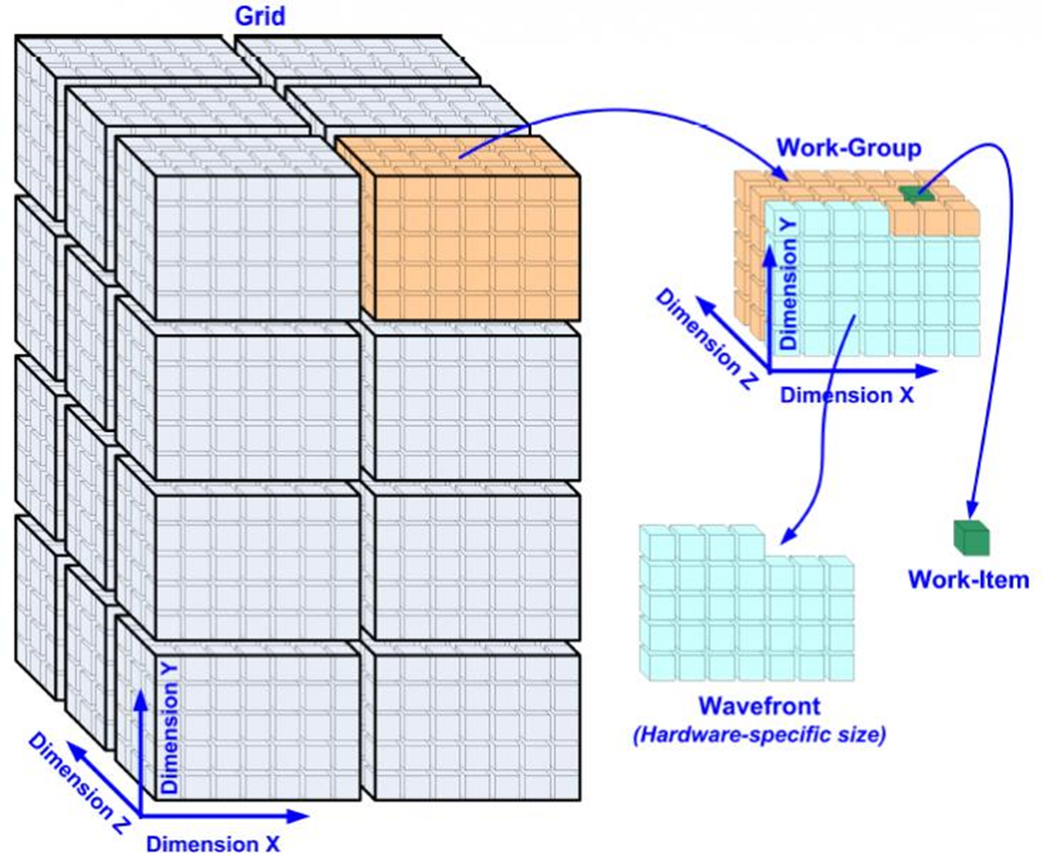
How it Works
Work is broken up into a grid
3-dimensional
The GPU runs instances of our kernel
Each work item (“thread”) has an ID
Each instance of the kernel therefore has an ID
N compute units execute N work items
Waves

Slide 14
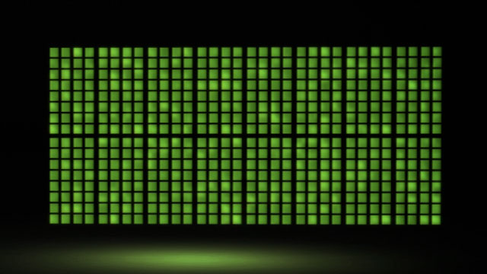
SIMT and Streaming
The GPU is a multi-processor system
Each processor is made up of numerous streaming processors
Each streaming processor can execute an instruction
Instructions and memory are streamed to the processors
This has a knock-on effect for performance!

Slide 15
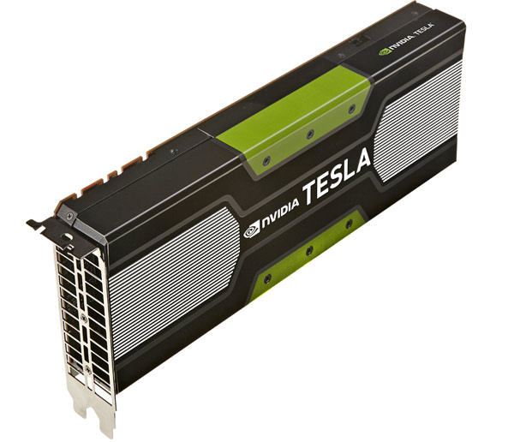
GPU Performance
Nvidia K40 Tesla Compute Card
We have two of these
2880 cores @ 745 MHz
2145.6 billion operations per second
About 150 times faster than our top end CPU

Slide 16
Problem Solving on the GPU

Slide 17
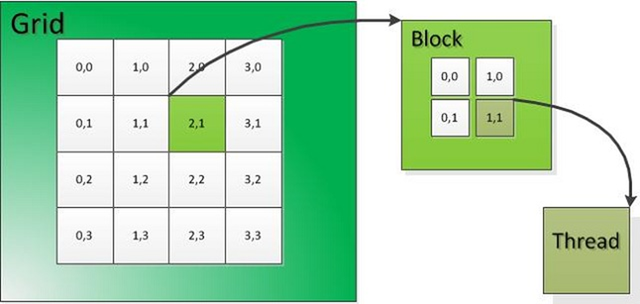
Problem Solving on the GPU
You have to think in matrix output
Each thread has an ID
(x, y, z) position in matrix
Output based on this location ID
Input can be shared

Slide 18
How to Problem Solve
Think in for loops first
Especially nested for loops – up to three levels
Think about your problem
Which parts can be parallelised?
Which parts are inherently sequential?
Look at for loops
Are there dependent values?
Are you working on large data sizes?
Think about how your data is worked on
Can you leave data on the GPU?
Can you stage the work and leave it on the GPU?
Do you need to reduce your result in some manner?
What happens at the sequential parts
Avoid memory copying as much as possible

Slide 19
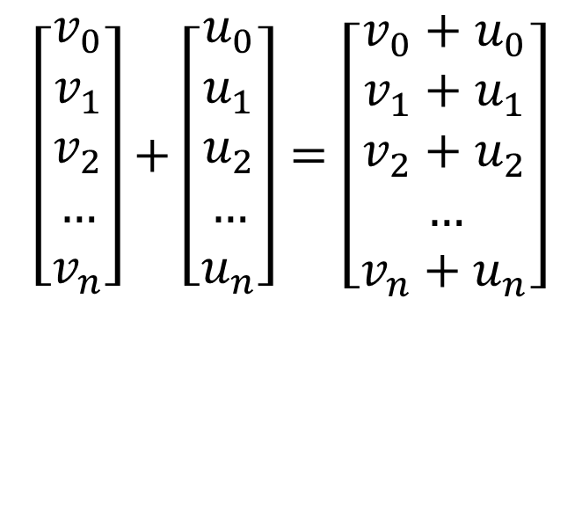
Example - Vector Addition
Hello World program of GPU programming
Add two N-dimensional vectors and store the result
$$\left[\begin{matrix}v_{0} \\ v_{1} \\ v_{2} \\ … \\ v_{n}\end{matrix}\right]+\left[\begin{matrix}u_{0} \\ u_{1} \\ u_{2} \\ … \\ u_{n}\end{matrix}\right]=\left[\begin{matrix}v_{0}+u_{0} \\ v_{1}+u_{1} \\ v_{2}+u_{2} \\ … \\ v_{n}+u_{n}\end{matrix}\right]$$

Slide 20
Sequential For Loop
vector<int> v;
vector<int> u;
vector<int> t;
for (int i = 0; i < N; ++i)
t[i] = v[i] + u[i];
Simplest approach
How most programmers think

Slide 21
Parallel For Loop
vector<int> v;
vector<int> u;
vector<int> t;
#pragma omp parallel for num_threads(M)
for (int i = 0; i < N; ++i)
t[i] = v[i] + u[i];
Naïve parallelism
Simplest to achieve
Good for embarrassingly parallel problems
Each thread processes N/M data points

Slide 22
Parallel For Operation
void vecadd(int idx, vector<int> &v, vector<int> &u, vector<int> &t)
{
t[idx] = v[idx] + u[idx];
}
int main()
{
// …
#pragma omp parallel for num_threads(M)
for (int i = 0; i < N; ++i)
vecadd(i, v, u, t);
}

Slide 23
Parallel For Operation
void vecadd(vector<int> &v, vector<int> &u, vector<int> &t)
{
// Hypothetical – OpenMP will allocate 64 threads max
int idx = omp_get_thread_num();
t[idx] = v[idx] + u[idx];
}
int main()
{
// …
#pragma omp parallel for num_threads(N)
for (int i = 0; i < N; ++i)
vecadd(v, u, t);
}

Slide 24
GPU Execution
__kernel void vecadd(__global int *v, __global int *u, __global int *t)
{
int idx = get_global_id(0);
t[idx] = v[idx] + u[idx];
}
int main()
{
// Set up of host and device
// Launch kernel
}

Slide 25
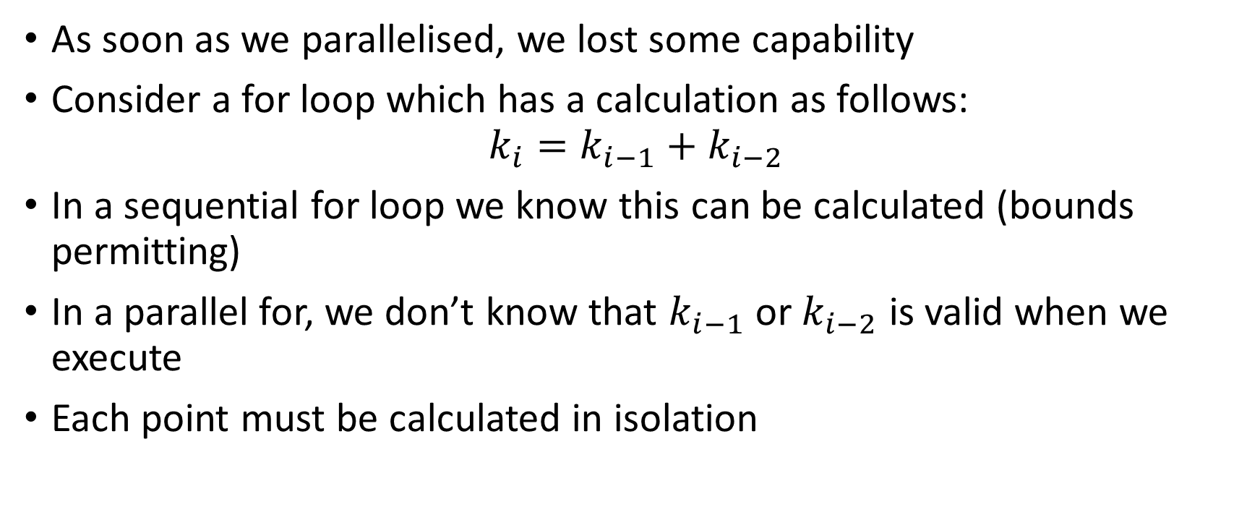
What Have we Lost?
As soon as we parallelised, we lost some capability
Consider a for loop which has a calculation as follows:
$$k_{i}=k_{i−1}+k_{i−2}$$
In a sequential for loop we know this can be calculated (bounds permitting)
In a parallel for, we don’t know that $k_{i−1}$ or $k_{i−2}$ is valid when we execute
Each point must be calculated in isolation

Slide 26

Problem / Work Spaces
The key idea is to think of your work dimensions
Work space has two dimensions
Block dimensions – (x, y, z) dimension of work items
Grid dimensions – (x, y, z) dimension of blocks
Dimensions can be limited
e.g. CUDA supports a block size extent of (1024 x 1024 x 64)
Memory can be shared between global and block spaces

Slide 27
Some Things to Consider
Streaming instructions limit the parallelisation
Branching instruction
Cannot stream instruction(s) following a branch – depends on the branch taken
Sequential computation will take place
Avoid branching instructions
Working with memory
Memory bus speed to GPU is slow
Copying data to and from GPU is your bottleneck
Avoid memory copying as far as possible

Slide 28
Programming the GPU

Slide 29
Program Structure
Every GPU program follows a basic similar structure
[Initialise]
Create Host Memory
Allocate GPU Memory
Copy Memory from Host to Device
Run Kernel(s)
Copy Result Memory from Device to Host
[Reduce Results]

Slide 30
Initialisation
Obviously platform dependent
OpenCL
Quite a bit of code
CUDA
Minimal code
Interrogate for devices
Select a relevant device
Set up any other requirements

Slide 31
Memory
Memory is the sticking point when working with the GPU
Allocate host (CPU main) memory and initialize
Allocate device (GPU main) memory
Copy host memory to device memory
Execute kernel(s)
Copy result memory from device to host
When allocating remember you need somewhere to store your results
Both on the device and host
Can treat memory as textures
GPU has fast texture fetch and write operations

Slide 32
Execute your Kernel(s)
Basically tell the GPU to execute a program
For N kernels
Memory?
Set the parameters
Run the kernel
Synchronise?
Copy results?
Reduce?

Slide 33
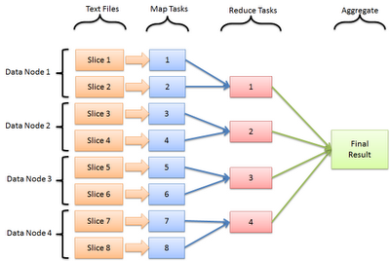
Reduce
GPU is not great for map-reduce tasks
Typical big data approach
Can build a reduce mechanism
Expensive
Easier to work on the CPU

Slide 34
Some Frameworks

Slide 35

OpenCL
Open standard supported by Khronos group
OpenGL
Cross platform
Nvidia, AMD, Intel, Qualcomm
More than GPU
CPU treated as an OpenCL device
Vector addition example – 40-50 LOC plus kernel

Slide 36

CUDA
Nvidia proprietary technology
~20% faster than OpenCL on Nvidia hardware
Good tool support
Single file solution
C++ compiler → CUDA compiler
Simpler to understand?
Vector addition example – 20 LOC plus kernel

Slide 37
C++ AMP
Microsoft developed open standard
Currently only supported by MS C++ compiler
Cross platform
Nvidia, AMD, Intel
Runs on DirectX 11 at present
OpenCL backend prototype available
Single file solution
Pure C++
No need to worry about device setup
Vector addition example – 10 LOC including function
// Function to run on the GPU
auto vecadd = [=](index<1> idx) restrict(amp)
{
// Get our index
unsigned int i = idx[0];
// Add the two vectors together
buffer_C[i] = buffer_A[i] + buffer_B[i];
};
// Execute the function
parallel_for_each(buffer_C.extent, vecadd);

Slide 38


Compute Shaders
Added to the graphics standards in recent APIs
Allow graphics programmers to exploit the GPU under the same model they are used to
Shader writing
Not recommended if you just want GPU power

Slide 39


SyCL
A new C++ standard for OpenCL
Supported by Khronos group
One of the main developers are Codeplay
Edinburgh based company
We have 3 students / graduates working with them

Slide 40
Examples

Slide 41


Slide 42
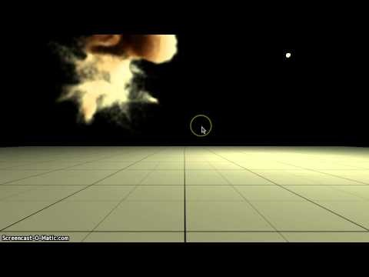

Slide 43


Slide 44


Slide 45
Summary

Slide 46
Summary
GPU can give you 200 times performance boost in theory…
…but you need to think of your problem – does it parallelise?
You need to think in matrices of data
You need to think in (nested) for loops

Slide 47

Some Further Resources
Both Nvidia (CUDA) and AMD (OpenCL) provide good material
Microsoft provide C++ AMP material
We are now a Nvidia CUDA Teaching Center
Only us and Edinburgh are in Scotland

Slide 48
Some Further Resources
IIDI Cluster
Custom Built PC
2 x quad core machines
8 cores per machine
18 machines total
144 cores total
Possible performance
2 GHz clock
288 GHz total
2.5 GHz clock
360 GHz total
3 GHz clock
432 GHz total
Quad core 3.5 GHz processor
14 GHz total
Nvidia 780 GTX
2304 cores
862 MHz clock
1986 GHz total
Nvidia K40 Compute
2880 cores
745 MHz clock
2146 GHz total
Total 4146 GHz

Slide 49
Questions?

